Slide 1
INFO5100 20240 Application Engineer & Dev SEC 30 Fall 2023 [OAK-2-TR]
Professor：Sergey K. Aityan
Blood Pressure Monitor
Team name:
Yin and Yang
Team members:
Shuhan Ji: 002857464
Rushikesh Prajapati: 002809751
Zhongwen Yang: 002816147
Yiran Chen: 002839117
Yazhen Han: 002950305
Yuchen Zhou: 002833031
Tuesday December 12th, 2023

Slide 2
Agenda
Group Members
Project Overview
Design Document
Frontend Part
Database Part
Backend Part
Demo Display

Slide 3





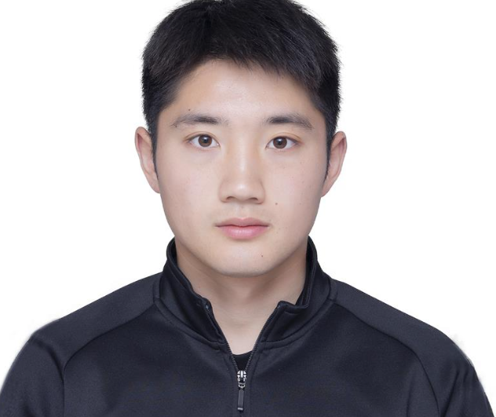
Group Members
Shuhan Ji
002857464
Yuchen Zhou
002833031
Yazhen Han
002950305
Zhongwen Yang
002816147
Rushikesh Prajapati
002809751
Yiran Chen
002839117

Slide 4
Project Overview
System Definition
The Blood Monitor application is designed to monitor and analyze key blood pressure metrics, including Diastolic Pressure, Systolic Pressure, and Heart Rate. Built with Vue.js for the frontend and Spring Boot for the backend, it provides a user-friendly interface for real-time tracking and personalized health monitoring.
Requirements
Data Visualization:
Real-time display of Diastolic Pressure, Systolic Pressure, and Heart Rate data using Vue.js and the EChart library.
Chart.js utilizes data representation to generate graphs for Diastolic Pressure, Systolic Pressure, and High Blood Pressure.
Date Range Filtering:
Users can filter data by selecting a specific one-week date range using Vue components.
Metric Switching:
Users can switch between different blood pressure metrics, such as Diastolic Pressure, Systolic Pressure, and Heart Beats, using navigation buttons within Vue components.
Real-time Updates:
Data visualizations update in real-time based on the user-selected date range.

Slide 5
Design Document
Architecture:
The Blood Monitor application follows a client-server architecture.
Frontend: Developed using Vue.js and Element UI for the user interface, utilizing the Charts.js library for dynamic data visualization.
Backend: Built using Spring Boot for the server-side configuration, implementing CRUD operations on data using Spring Data JDBC and Spring JPA.
Database Schema:
The application's database will store user data, including date, Diastolic Pressure, Systolic Pressure, and Heart Rate.
APIs:
GET /bloodpressure/{startTime}/{endTime}: Retrieves blood pressure data within the specified date range.
GET /bloodpressure: Retrieves all blood pressure data.
User Interface Flow:
User selects a date range using the Date Picker component.
Application fetches relevant blood pressure data from the server based on the selected date range.
Data is displayed using ECharts charts.
Graphs are generated using data time and blood pressure measurements to represent the information visually.
Users can switch between Diastolic Pressure, Systolic Pressure, and Heart Beats using navigation buttons.

Slide 6
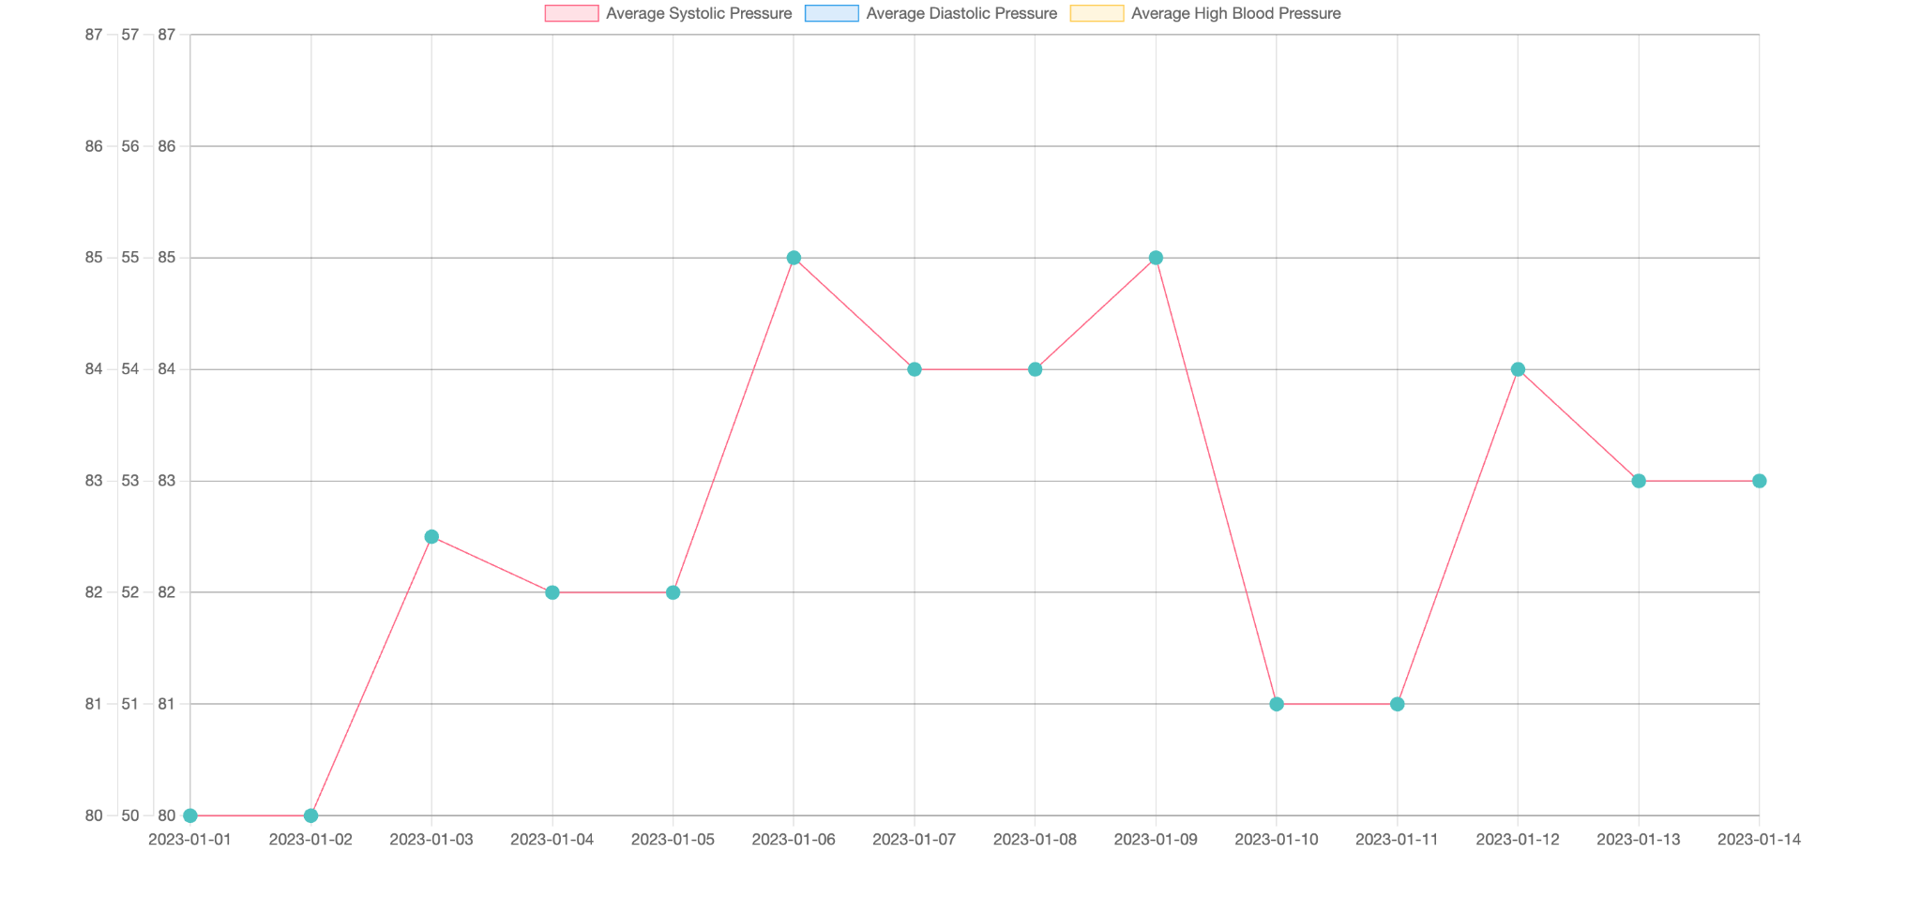
Frontend part1
The Chart.js script is employed in conjunction with HTML functionality to create a Chartjs.
The chart seamlessly utilizes input-generated data, making the process straightforward.
This simplistic chart effectively communicates information about various blood pressure types.
Additionally, the chart is responsive within the system.

Slide 7
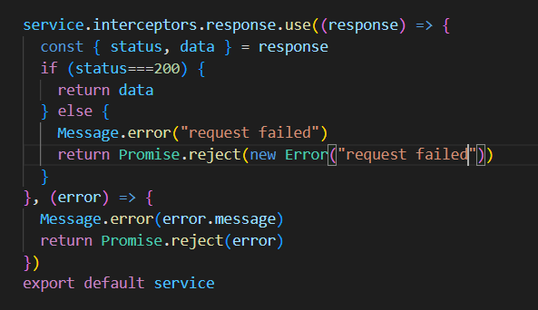
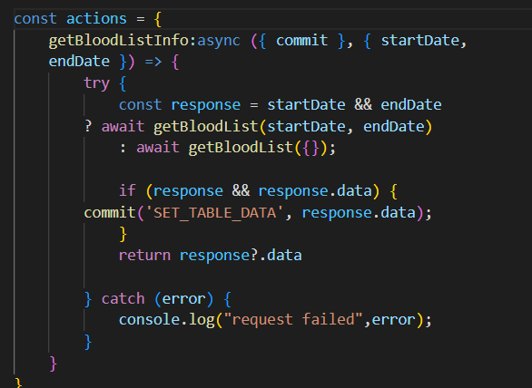
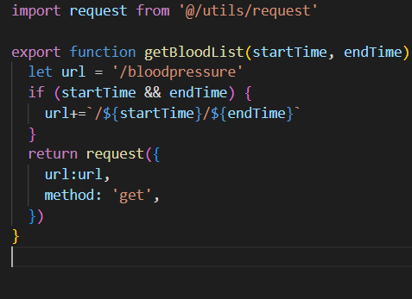
Frontend part2 Yazhen Han
Packaged the request files including encapsulating Axios requests(configured request interceptor and response interceptor )
Configured a state management system using Vuex
Coordinated with the backend by calling API
Created a table with various health metrics for data visualization(systolic pressure,diastolic pressure, heart beats, avg systolic pressure etc..)
Added a date filter to display data for specific dates
Configured a proxy to address cross-origin issues in vue.config.js

Slide 8
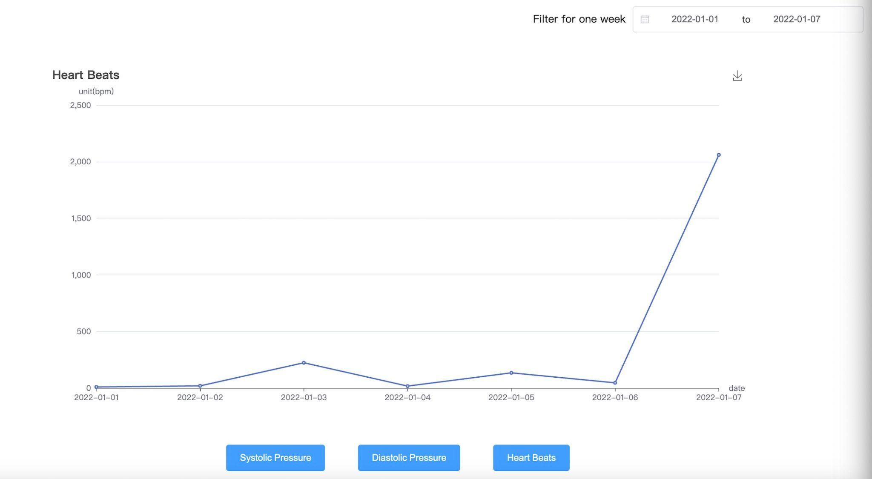
Frontend part3
The main components include the Date Range Filter, ECharts Chart, and Navigation Buttons.
Date Range Filter: This component allows users to select a one-week timeframe for in-depth analysis.
ECharts Chart: I use ECharts to display the line charts for systolic pressure, diastolic pressure, and heart beats using in the frontend. It provides a real-time representation of blood pressure over the selected timeframe.
Navigation Buttons: Users can seamlessly switch between different blood pressure metrics using navigation buttons, enhancing the user experience and enabling comprehensive health tracking.
On the technology front, we've utilized Vue.js as our frontend framework, Element UI for customizable UI components, and ECharts for dynamic data visualization.
Notes:
Hello everyone, I'm glad to be here to introduce you to some of the key components and technologies that I was responsible for writing and involved in this project.
The main components include the Date Range Filter, ECharts Chart, and Navigation Buttons.
Date Range Filter: This component allows users to select a one-week timeframe for in-depth analysis.
ECharts Chart: I use ECharts to display the line charts for systolic pressure, diastolic pressure, and heart beats using in the frontend. It provides a real-time representation of blood pressure over the selected timeframe.
Navigation Buttons: Users can seamlessly switch between different blood pressure metrics using navigation buttons, enhancing the user experience and enabling comprehensive health tracking.
On the technology front, we've utilized Vue.js as our frontend framework, Element UI for customizable UI components, and ECharts for dynamic data visualization.

Slide 9
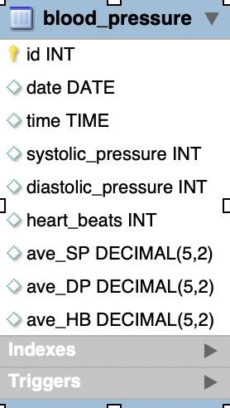
Database part
id: Primary key
date, time: Date and time of the blood pressure recording
systolic_pressure, diastolic_pressure, heart_beats: Raw data values
avg_SP, avg_DP, avg_HB: Average values calculated by the trigger
Notes:
pumb and relax delivering oxygen and nutrients blood flow

Slide 10
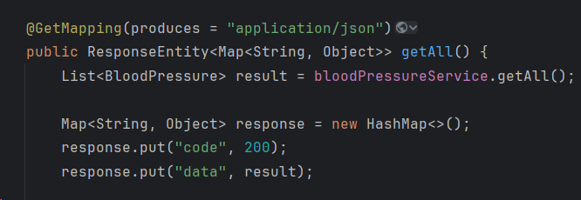
Backend part1
Project dependencies
1.Spring Boot JDBC
2.Spring Boot Data JPA
3.MySQL Connector Java
4.Spring Boot Web
5.Lombok
Notes:
We use some packages to develop our serve-side configuration. Our serve-side is based on SpringBoot. We use SpringBoot JDBC and SpringBoot Data JPA to implement the CRUD operations in our database. Use MySQL Connoector to connect our database. And we use SpringBoot Web to implement some HTTP request. Like use GetMaping to send data we need to frontend. And Using Lombok to annotate entity classes and map them to corresponding tables in the database.

Slide 11
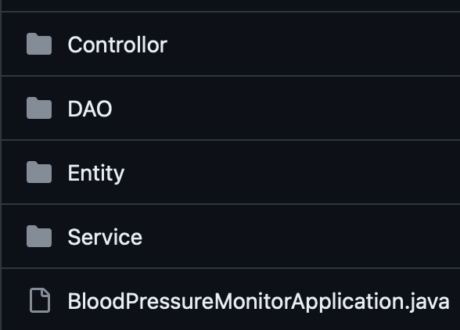
Backend part2
layered architecture
1.Controller
2.Dao
3.Entity
4.Service
Notes:
the three-layer structure of Spring MVC contributes to building clear, maintainable, and scalable web applications, enhancing code organization and testability.
Controller Layer:
Purpose:
Handles user requests and input.
Directs requests to the appropriate business logic (Service layer).
Validates and processes request parameters.
Returns the relevant view to the user.
Service Layer:
Purpose:
Houses the application's business logic.
Executes business operations based on requests from the Controller layer.
May interact with the DAO layer for data access.
Data Access Layer (DAO):
Purpose:
Manages interactions with the database.
Provides an abstraction for database operations.
Supports transaction management for data integrity.

Slide 12
System live demo

Slide 13
Conclusion
This application specification outlines the system definition, requirements, and design document for the Blood Monitor project. It provides a foundation for development and collaboration among team members involved in the project.

Slide 14
Thank you！

